Slide 1
CONVERTING COLOUR IMAGE TO THE BINARY EQUIVALENT IMAGE
PROJECT
SUBJECT :DIGITAL IMAGE PROCESSING
STUDENT NAME : BODIPUDI KRISHNA PRIYA
DEPARTMENT : CSE[AIML]

Slide 2
OUTLINE
Problem Statement
Technology used
Wow factor
End users
Result
Conclusion
Git-hub Link
Future scope

Slide 3
PROBLEM STATEMENT
The objective of this project is to convert a given color image (in RGB format) into a binary image, where each pixel is either black (0) or white (1). The conversion process involves analyzing the intensity of each pixel’s color values and applying a threshold to classify the pixel as either black or white. The algorithm should allow users to specify a threshold value or use an automatic thresholding method like Otsu’s. The input will be a color image in formats such as JPEG or PNG, and the output will be a binary image where color variations are simplified into black-and-white pixels. This process is widely used in image processing tasks like optical character recognition (OCR), data compression, and feature extraction. The project will focus on efficiently processing the image and generating a binary output that preserves the important features of the input image.

Slide 4
TECHNOLOGY USED
Programming Language:
Python: Python is chosen for its simplicity and availability of powerful image processing libraries.
Libraries:
OpenCV: A highly efficient library for image processing tasks, including reading, manipulating, and saving images. It provides functions for color conversion, thresholding, and other image manipulation operations.
NumPy: A library used for handling arrays and matrices, essential for working with pixel data and performing mathematical operations efficiently.
Matplotlib: Used for visualizing the binary image results in a plot, allowing users to view the images after processing.
Pillow (PIL): Used for opening, manipulating, and saving image files in various formats.
Platforms:
Jupyter Notebook or Google Colab: Platforms that support Python code execution and allow easy visualization of images for testing and development purposes.
Visual Studio Code or PyCharm: IDEs for writing, testing, and debugging the code, offering useful extensions for Python development.
Image Formats:
JPEG, PNG, BMP: Common image formats supported for input and output. These formats are widely used for color and binary images in real-world applications.

Slide 5
WOW FACTORS
This project stands out due to several unique features. It incorporates automatic thresholding techniques, such as Otsu's method, which intelligently determines the optimal threshold for binarization, reducing manual intervention. Additionally, it offers customizable threshold settings, allowing users to fine-tune the process based on the specific characteristics of the image. The project is optimized for high-speed processing, enabling it to handle large images efficiently, making it suitable for real-time applications. Its cross-platform compatibility ensures that the solution works seamlessly on various operating systems, including Windows, macOS, and Linux. The real-time image visualization feature using Matplotlib provides immediate feedback, helping users easily see the results. Supporting multiple input formats like JPEG, PNG, and BMP, the project is highly flexible. The grayscale conversion option simplifies processing for more efficient thresholding, while its scalability allows it to handle both small and large images effectively. Serving as an educational tool, it provides hands-on experience with core image processing concepts, making it an excellent learning resource. Ultimately, this project combines simplicity with powerful features, offering a practical yet accessible solution for image binarization.

Slide 6
END USERS
The end users of this project include researchers and academics in image processing and computer vision, who can use the tool to preprocess images for tasks like object detection or image recognition. Software developers working on OCR, document processing, or image compression applications will find the binary conversion process crucial for their workflow. Data scientists who require binary images for machine learning models, such as pattern recognition and image classification, will also benefit from this project. Healthcare professionals working with medical images can use it to simplify and preprocess images like X-rays or MRIs for further analysis.
In addition, graphic designers and photographers can use this tool for artistic purposes or preparing images for digital printing. Students and educators in image processing and computer vision fields will find this project a valuable educational resource for learning about image analysis techniques. Industry professionals in manufacturing and quality control can apply the binary conversion in automated visual inspection systems to detect defects in products. Overall, the project serves a diverse range of users who need an efficient, accessible method for converting color images to binary form for various applications.

Slide 7

INPUT

Slide 8
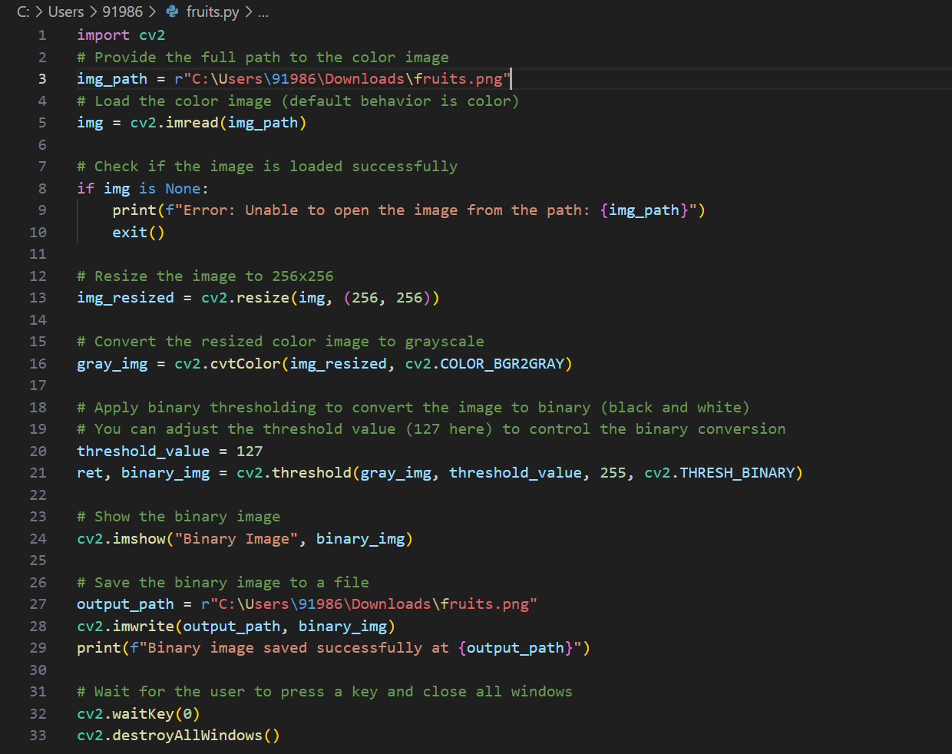
PROGRAM

Slide 9
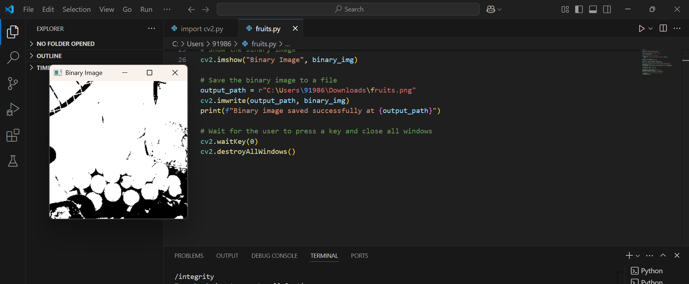
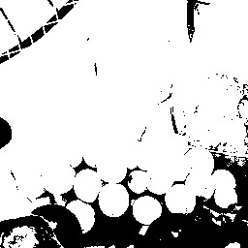
OUTPUT

Slide 10
CONCLUSION
In conclusion, this project successfully addresses the problem of converting a color image into its binary equivalent by employing efficient image processing techniques. By using advanced thresholding methods like Otsu's and providing the flexibility for manual threshold adjustments, the project ensures that the resulting binary image accurately represents the key features of the original color image. The solution is scalable, optimized for high-speed processing, and cross-platform compatible, making it suitable for a wide range of use cases, from OCR and machine learning to artistic applications. Additionally, the project provides a valuable tool for various professionals, including researchers, software developers, data scientists, and educators. By converting complex color images into simplified binary formats, this project lays the foundation for numerous real-world applications in fields such as medical imaging, quality control, and computer vision. Ultimately, it offers an accessible yet powerful method for enhancing image analysis, making it a significant contribution to the broader field of image processing.

Slide 11
GITHUB LINK
https://github.com/bodipudikrishnapriya/changing-colour-image-into-binary-equivalent-image.git

Slide 12
Future scope
Adaptive Thresholding: Implementing dynamic thresholding methods that adjust based on image content, improving accuracy in varying conditions.
Advanced Image Segmentation: Expanding the project to segment images into distinct regions or objects, enabling more complex analyses.
Machine Learning Integration: Incorporating machine learning algorithms for automated image classification and recognition tasks.
Real-Time Processing: Optimizing the algorithm for real-time use in applications like live image processing and automated inspection systems.
Mobile and Web Applications: Developing mobile and web-based versions to make the tool accessible on various devices and platforms.
Noise Reduction and Image Enhancement: Adding pre-processing steps like noise reduction and enhancement to improve the quality of binary images.
Text and Pattern Recognition: Enhancing the project for OCR and pattern recognition applications using the binary images generated.

Slide 13
THANK YOU

